Slide 1

Data Visualization Final Project
Miltiadis Hadjipanayiotou · Odysseas Koufos · Quinn Dziwura
BUS 32130 · Data Visualization for Decision-Making · Spring 2026
Notes:
Hi I am Odysseas…Miltiadis…. And Quinn. We partnered with Odysseas’ startup Unloket

Slide 2
UNLOKET
There’s too much noise,
no actionable insights
65%
of hotels are understaffed
The front desk spends its day answering the same questions. Guest requests pile up. Any insights never reach management.
90%
requests are repetitive
Our group member Odysseas founded Unloket, an AI hospitality concierge That is a finalist in the 2026 New Venture Challenge. We used real data from his platform to build an analytics dashboard that shows what's actually happening.
60%
all interactions can be easily automated
Notes:
When staying at a hotel you’re likely going to have requests or need help from the front desk. And to ask these questions you either have to walk down to the front desk, call the front desk, or if they have the option of texting you text them.
These questions are usually all the same…..’When is checkout?’ Where is the gym? Can I get more towels?..... And Staff have to answer these questions one by one every single time.
One thing that Odysseas sought to capitalize on is that none of this information actually goes anywhere. Management has no idea what guests are actually asking, which problems keep coming up, and what is being done to fix them”
Unlocked seeks to solve this. Unlocked is an AI Concierge service that handles all of guest’s messaging automatically, over text and Whatsapp. He is using Unloket to compete in the 2026 New Venture Challenge and for this project, we pulled real data from the hotels that his company is working with, and built a dashboard to figure out what is actually going on.”
Open strong. Don't start with intros — just get into it.
'Hotels generate thousands of guest interactions every week and almost none of it gets analyzed. The front desk is buried answering the same questions, and management has no visibility into what's actually happening on the floor.'
'One of our group members, Odysseas, is actually building the solution — Unloket is his startup, competing in this year's New Venture Challenge. He gave us direct access to real SMS data from a live hotel property, and we built a dashboard to surface what was actually going on.'
~45 seconds. Establish the pain before you explain the solution.

Slide 3
UNLOKET
Where the data came from
SMS & WhatsApp Logs
3,641 Messages
First-Hand Access
Real guest-to-hotel conversations pulled directly from Odysseas' platform. Every message sent and received through Unloket at a live pilot property.
Spanning December 2025 through April 2026, five months of live operational data across 8 inquiry categories and 15+ locations.
No third-party scraping, no synthetic data. This is live data from Odysseas' platform, that we pulled directly for this project.
Dataset fields
Inquiry Category
Handler (AI vs. Staff)
Satisfaction Score
Response Time
Message Direction
Timestamp
Guest Phone
Message Body
Notes:
The largest component of the data is about 3,600 messages from 5 months of real conversations between guests and the hotel at 16 different locations. These messages are pulled straight from Odysseas’ platform so they’re not scraped from somewhere or made up in any sort of way. These actual messages are tagged with things like what kind of request it was, whether AI handled it or staff handled it, how long it took to respond and how satisfied the guest was. We of course had to clean up this data before incorporating it or building anything with it. We filtered out nulls, had to run some topic modelling…
Keep it under 40 seconds.
'The data came directly from Odysseas's platform — real SMS and WhatsApp conversations between guests and a hotel his company is actively working with. 3,641 messages, five months, one live property.'
'Each message was logged with the inquiry category, who handled it, response time, satisfaction scores, and timestamps. We cleaned and validated everything before building anything — filtering out nulls rather than imputing them.'

Slide 4
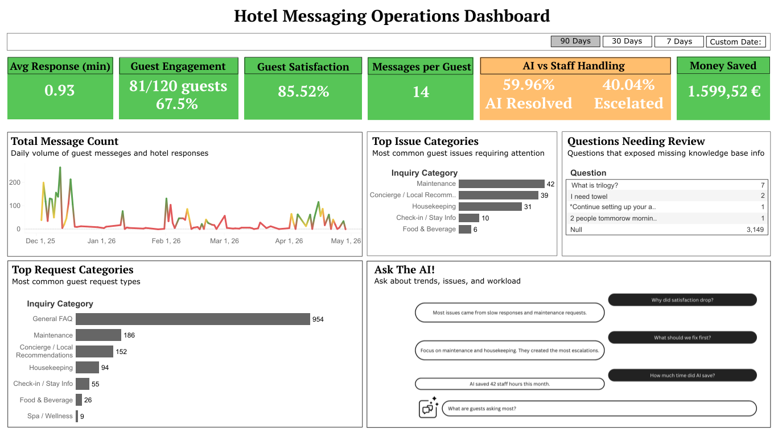

Slide 5
UNLOKET
Let's look at the dashboard.
Switch to Tableau
Notes:
So up top you've got the KPI tiles — satisfaction is sitting at 86%, response time is fast, AI is handling about 36% of conversations on its own. If you drop down to the categories, General FAQ is by far the biggest — that's 63% of all requests, stuff the AI handles easily. Maintenance is where most of the escalations happen — that's where a human still needs to get involved. And the line chart shows you how usage trended over time.
One line: 'Here's the dashboard.' Then switch to Tableau.
Have it open and ready before you start presenting.

Slide 6
UNLOKET
Why this matters
What the data showed us
The bigger picture
General FAQ dominates
Hotel managers have no visibility into their own operations. This dashboard changes that.
63% of all requests are questions the AI handles instantly. Biggest efficiency opportunity on the platform.
AI handled 36% of conversations
Already resolving more than a third of guest interactions with zero staff involvement.
AI tools are only as good as the insights they surface. Data without visualization is just noise that you don’t know what to do with.
86% guest satisfaction
Above industry benchmarks, despite most interactions being AI-handled.
For Odysseas, this dashboard is a sales tool, proof that Unloket generates measurable ROI for hotels.
Maintenance is the top escalation
The category most likely to need a human
For the New Venture Challenge, this is what separates a product from a real business.
Notes:
After seeing our dashboard and data, what does this actually tell us?
The AI is already handling more than a third of conversations with zero staff involvement, and guests are still coming away satisfied 86% of the time. We are happy with that stat.
The biggest opportunity is still the general Frequently Asked Question, that’s where most of the volume is and that is exactly what the AI is built for.
But the biggest thing for us is what this dashboard means to Odysseas. In the past, when he's pitching Unloket to a hotel, he's basically demoing the AI and hoping they believe it works. With this, he can walk in and show them exactly what happened at a real property…. “Here's your response time, here's your satisfaction score, here's how much staff time you saved.” That's incredibly valuable from his perspective.
And for the New Venture challenge, this is the difference between having a cool product and having a real business case you can discuss.
Landing slide after the dashboard demo. Bring it home.
'What did we actually learn?' Hit the four findings on the left, one sentence each.
Then pivot right: 'But here's the bigger point. Most hotels have no structured view into what's happening on the floor. This dashboard gives Odysseas's clients that for the first time.'
'When he walks into a sales conversation, he can show a hotel owner exactly what the platform surfaced at his last pilot property. That's a completely different conversation than just demoing the AI.'
'For the New Venture Challenge — this is the difference between having a product and having a business.'
Close there. Total should be right at 4-5 minutes.

